Slide 1
Gradient Boosting

Slide 2
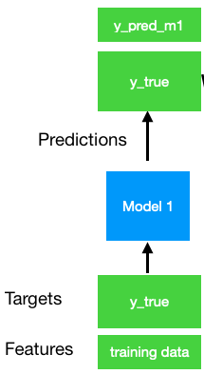
Gradient Boosting
Series of weak learners become a strong learner
Series of models, focuses on learning the mistakes it’s predecessor makes (by learning the residual errors)

Slide 3
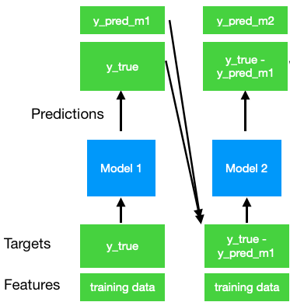
Gradient Boosting
Series of weak learners become a strong learner
Series of models, focuses on learning the mistakes it’s predecessor makes (by learning the residual errors)

Slide 4
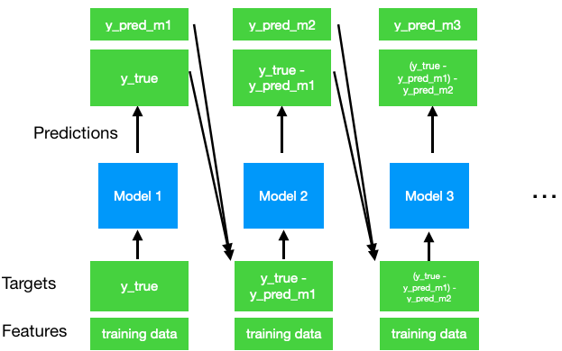
Gradient Boosting
Series of weak learners become a strong learner
Series of models, focuses on learning the mistakes it’s predecessor makes (by learning the residual errors)

Slide 5
Gradient Boosting
Series of weak learners become a strong learner
Series of models, focuses on learning the mistakes it’s predecessor makes (by learning the residual errors)
Final prediction sums up all the predictions of each stage

Slide 6
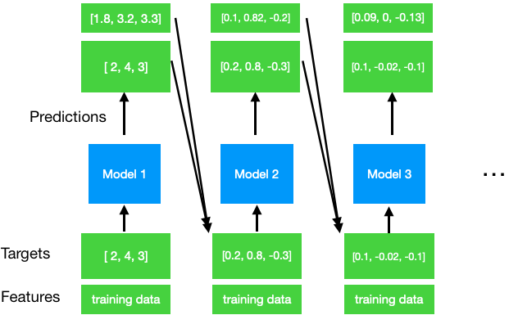
Gradient Boosting
Sum of predictions: [1.8 + 0.1 + 0.09, 3.2 + 0.82 + 0, 3.3 + -0.2 -0.13]

Slide 7
Gradient Boosting
Sum of predictions: [1.8 + 0.1 + 0.09, 3.2 + 0.82 + 0, 3.3 + -0.2 -0.13]
Final prediction: [1.99, 4.02, 2.97]
True values: [2, 4, 2]

Slide 8
Considerations
How many models should you add?
Look for a minimum in validation error and perform early stopping
Models trained in series, not as scalable bagging/pasting
XGBoost
Optimized gradient boosting, faster and more scalable

Slide 9
Regularization
High number of estimators can lead to overfitting
Best practice to choose number of estimators by early stopping

Slide 10





Regularization
Shrinkage
Best practice use a low learning rate ( <= 0.1), found to result in better test errors
Lower requires more estimators

Slide 11
Regularization
Shrinkage
Bagging
Performing bagging + shrinkage can result in even better perfm.
Bagging without shrinkage for Grad. Boost is not as good
Good bagging subsample size is around 0.5 (50%)
Subspaces not as effective on perfm., good for training/run time

